Slide 1
Exploring Customer’s Churn
in a Telecom Company.
Made by Christos Vamvakousis.

Slide 2
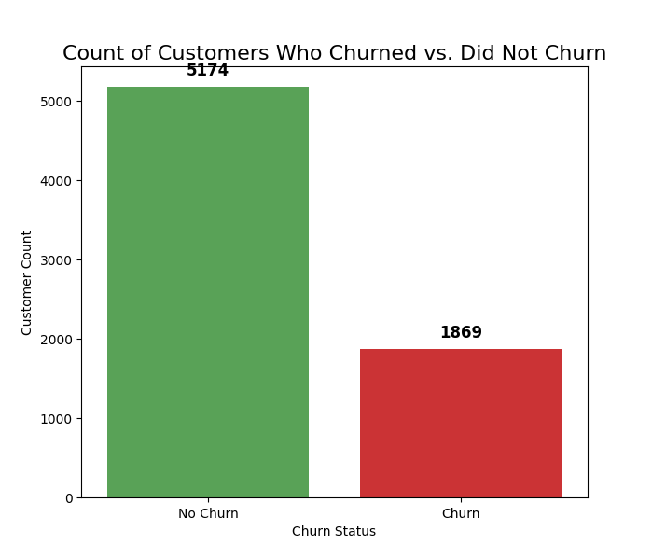
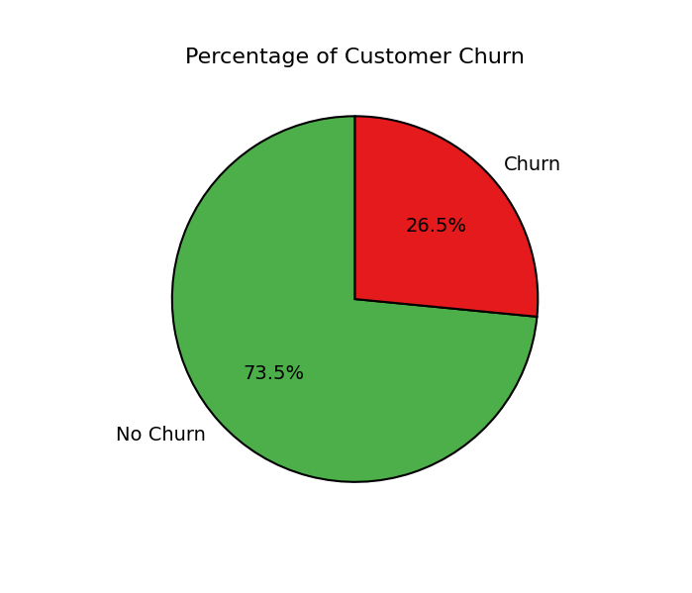
Customer Churn Overview

Slide 3
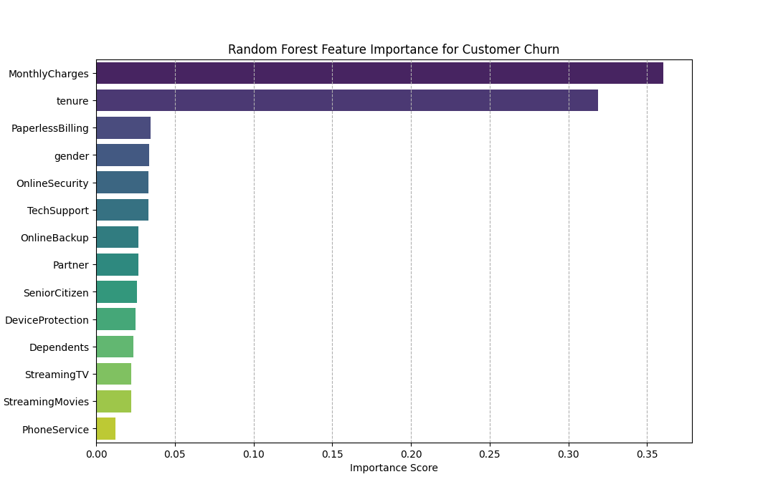
Key Drivers of Customer Churn
A 26.5% churn rate signals significant customer instability. To mitigate this risk, we must now move to identify the underlying causal factors revealed by our analysis.
Dominant Predictors: MonthlyCharges and tenure outperform all other features combined, driving the majority of the model's predictive power.
Price Sensitivity: High monthly costs represent the primary trigger for customer attrition.
Lifecycle Risk: Low tenure identifies the first year as the critical period for retention efforts.

Slide 4
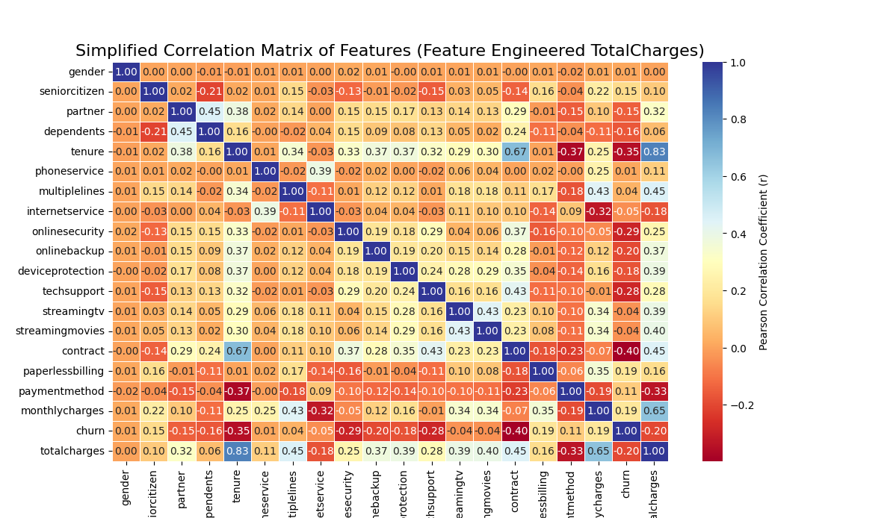
Top 2 Churn Drivers: Cost and Lifecycle Risk
1. Price Sensitivity and Digital Risk
      Proof: Strong positive correlation with both TotalCharges, MonthlyCharges and PaperlessBilling (r=0.20 and r=0.19).
      Observation: Customers with higher costs and digital billing habits are the most susceptible to churn.
      Risk: This indicates overpricing is a major issue, driving customers who monitor their bills closely to switch providers.
  2. Onboarding Friction (Tenure and contract)
      Proof: Strongest negative correlations in the dataset (r=-0.35 and r=-0.40). Time builds loyalty.
      Critical Window: The highest churn risk is concentrated in the first 12 months of the customer lifecycle.
      Diagnosis: The early customer experience is failing to establish perceived value, leading to rapid early defection.

Slide 5
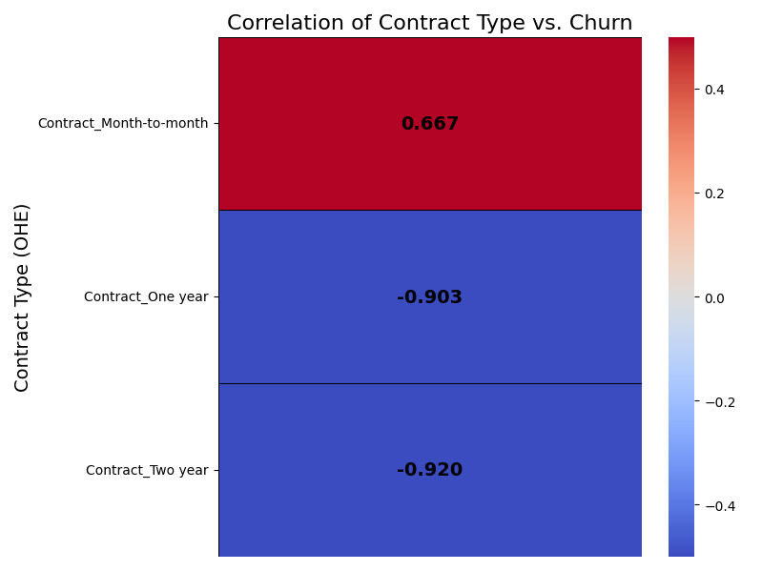
Tenure & Contract: The Early-Life Risk Window
The Critical 12-Month Churn Window:
  Tenure Risk: Our strongest negative correlation (r=-0.35) proves that loyalty is earned through time. The majority of attrition occurs within the first 12 months of the customer lifecycle.
  The Root Cause: This high early risk is enabled by the Month-to-Month contract (r=0.667), which provides an easy, low-friction exit route.
  The Profile: Our most likely churner is a New Customer on a Month-to-Month Contract

Slide 6
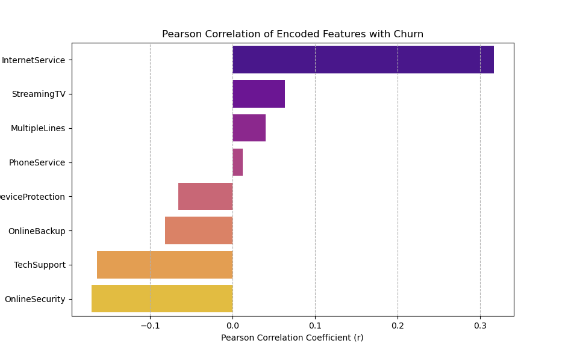
What specific services cause these problems?
Having identified Cost as a primary driver, we now analyze the specific services generating those costs to pinpoint the product-level root cause.
The Internet Service Factor: Among all service categories, InternetService is the strongest differentiator between churners and loyal customers.
The Value-Add Anchors (Retention): Tech Support and Online Security show consistent negative correlations, customers who engage with them are significantly “less likely to churn”.

Slide 7
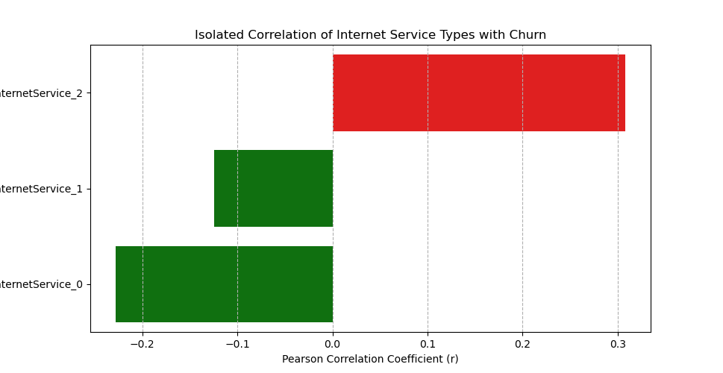
Deep Dive: The Fiber Optic Disconnect
The Fiber Optic Problem
  Positive Correlation: The strongest positive correlation is found with Fiber Optic.
  Diagnosis: This confirms the churn problem is isolated to our flagship, premium service.
  Implication: High pricing for Fiber Optic is not matched by perceived value, leading to a critical Price-to-Value Mismatch.
The Stability Contrast (Retention Anchors)
  Negative Correlation: Both DSL and No Internet show strong negative correlations.
  Insight: These lower-cost options act as crucial Retention Anchors, proving that stability and affordability generate strong loyalty.
  Conclusion: We must stabilize the Fiber Optic customer base or the current price structure will continue to erode the digital segment of our market.
(Fiber Optic)
(DSL)
(No Internet Service)

Slide 8
Cause Summary: The Early-Life Risk Window
The High-Risk Profile:
  The "When": Churn spikes in the first 12 months (Onboarding Friction).
  The "How": The “Month-to-Month” contract enables immediate exit (r=0.667).
  The "Why": The high cost associated with Fiber Optic services indicates a crucial price-to-value mismatch.
The Missed Opportunity:
  High-risk customers are failing to adopt the proven retention anchors: Tech Support and Online Security.

Slide 9
Strategic Recommendations
To reduce the 26.5% churn rate, we propose a three-pillared strategy focused on Value, Commitment, and Support.
Restructure Fiber Pricing
Address the Price-to-Value Mismatch. Introduce a "Starter Fiber" tier or a 6-month promotional rate to bridge the value gap for new users.
Incentivize Contracts
Target high-risk Month-to-Month customers. Offer a 15% Loyalty Discount for upgrading to a 1-Year committed contract.
Deploy "Safety Net" Bundle
Leverage proven anchors. Automatically bundle Tech Support & Security for free during the first 6 months to reduce onboarding friction.

Slide 10
THANK YOU
Technical Stack
Language: Python
Libraries: Pandas, Numpy, Scikit-Learn (RF), Matplotlib/seaborn

